Slide 1
Java File HANDLING

Slide 2
Java File Handling
The File class from the java.io package, allows us to work with files.
To use the File class, create an object of the class, and specify the filename or directory name:
Example
import java.io.File; // Import the File class
File myObj = new File("filename.txt"); // Specify the filename

Slide 3
Method | Type | Description
canRead() | Boolean | Tests whether the file is readable or not
canWrite() | Boolean | Tests whether the file is writable or not
createNewFile() | Boolean | Creates an empty file
delete() | Boolean | Deletes a file
exists() | Boolean | Tests whether the file exists
getName() | String | Returns the name of the file
getAbsolutePath() | String | Returns the absolute pathname of the file
length() | Long | Returns the size of the file in bytes
list() | String[] | Returns an array of the files in the directory
mkdir() | Boolean | Creates a directory

Slide 4
Create a File
To create a file in Java, you can use the createNewFile() method. This method returns a boolean value: true if the file was successfully created, and false if the file already exists. Note that the method is enclosed in a try...catch block. This is necessary because it throws an IOException if an error occurs (if the file cannot be created for some reason):

Slide 5
import java.io.File; // Import the File class
import java.io.IOException; // Import the IOException class to handle errors
public class CreateFile {
public static void main(String[] args) {
try {
File myObj = new File("filename.txt");
if (myObj.createNewFile()) {
System.out.println("File created: " + myObj.getName());
} else {
System.out.println("File already exists.");
}
} catch (IOException e) {
System.out.println("An error occurred.");
e.printStackTrace();
}
}
}

Slide 6


Slide 7
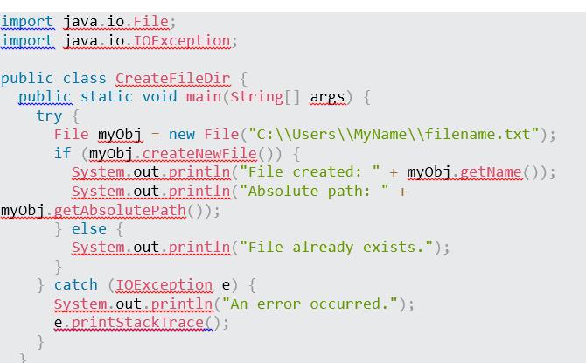

Slide 8
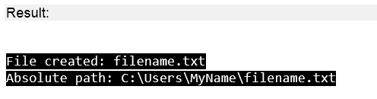

Slide 9
Write To a File
In the following example, we use the FileWriter class together with its write() method to write some text to the file we created in the example above. Note that when you are done writing to the file, you should close it with the close() method:

Slide 10
import java.io.FileWriter; // Import the FileWriter class
import java.io.IOException; // Import the IOException class to handle errors
public class WriteToFile {
public static void main(String[] args) {
try {
FileWriter myWriter = new FileWriter("filename.txt");
myWriter.write("Files in Java might be tricky, but it is fun enough!");
myWriter.close();
System.out.println("Successfully wrote to the file.");
} catch (IOException e) {
System.out.println("An error occurred.");
e.printStackTrace();
}
}
}

Slide 11


Slide 12

Java Read Files
In the following example, we use the Scanner class to read the contents of the text file we created in the previous chapter:
import java.io.File; // Import the File class
import java.io.FileNotFoundException; // Import this class to handle errors
import java.util.Scanner; // Import the Scanner class to read text files
public class ReadFile {
public static void main(String[] args) {
try {
File myObj = new File("filename.txt");
Scanner myReader = new Scanner(myObj);
while (myReader.hasNextLine()) {
String data = myReader.nextLine();
System.out.println(data);
}
myReader.close();
} catch (FileNotFoundException e) {
System.out.println("An error occurred.");
e.printStackTrace();
}
}
}

Slide 13
import java.io.File; // Import the File class
public class GetFileInfo { public static void main(String[] args) {
File myObj = new File("filename.txt");
if (myObj.exists()) {
System.out.println("File name: " + myObj.getName());
System.out.println("Absolute path: " + myObj.getAbsolutePath());
System.out.println("Writeable: " + myObj.canWrite());
System.out.println("Readable " + myObj.canRead());
System.out.println("File size in bytes " + myObj.length());
} else {
System.out.println("The file does not exist.");
}
}
}

Slide 14
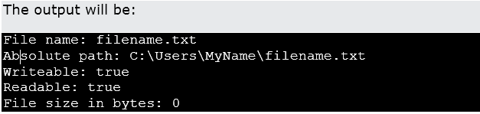

Slide 15

Delete a File
To delete a file in Java, use the delete() method:
Example
import java.io.File; // Import the File class
public class DeleteFile {
public static void main(String[] args) {
File myObj = new File("filename.txt");
if (myObj.delete()) {
System.out.println("Deleted the file: " + myObj.getName());
} else {
System.out.println("Failed to delete the file.");
}
}
}

Slide 16

Delete a Folder
You can also delete a folder. However, it must be empty:
Example
import java.io.File;
public class DeleteFolder {
public static void main(String[] args) {
File myObj = new File("C:\\Users\\MyName\\Test");
if (myObj.delete()) {
System.out.println("Deleted the folder: " + myObj.getName());
} else {
System.out.println("Failed to delete the folder.");
}
}
}

